Slide 1
FTP
FTP服务又称为文件传输服务，它是Internet中最早提供的服务功能之一，目前仍然在广泛使用中 ；
文件传输服务是由FTP应用程序提供的，而FTP应用程序遵循的是TCP/IP协议组中的文件传输协议，它允许用户将文件从一台计算机传输到另一台计算机上，并且能保证传输的可靠性；
在Internet中，许多公司、大学的主机上含有数量众多的各种程序与文件，这是Internet的巨大与宝贵的信息资源。通过使用FTP服务，用户就可以方便地访问这些信息资源。
1

Slide 2
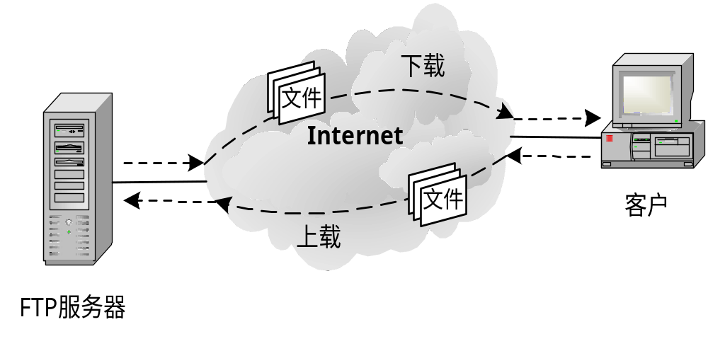
文件传输的工作过程
工作模式 ：客户/服务器

Slide 3
匿名FTP服务
匿名FTP服务的实质是：提供服务的机构在它的FTP服务器上建立一个公开账户（一般为anonymous），并赋予该账户访问公共目录的权限，以便提供免费服务；
大多数FTP服务都是匿名服务；
为了保证FTP服务器的安全，几乎所有的匿名FTP服务器都只允许用户下载文件，而不允许用户上载文件。

Slide 4
FTP的工作步骤
打开熟知端口（端口号为21），使客户进程能够连接上。
等待客户进程发出连接请求。
启动从属进程来处理客户进程发来的请求。从属进程对客户进程的请求处理完毕后即终止，但从属进程在运行期间根据需要还可能创建其他一些子进程。
回到等待状态，继续接受其他客户进程发来的请求。主进程与从属进程的处理是并发地进行。

Slide 5
两个连接
控制连接在整个会话期间一直保持打开，FTP 客户发出的传送请求通过控制连接发送给服务器端的控制进程，但控制连接不用来传送文件。
实际用于传输文件的是“数据连接”。服务器端的控制进程在接收到 FTP 客户发送来的文件传输请求后就创建“数据传送进程”和“数据连接”，用来连接客户端和服务器端的数据传送进程。
数据传送进程实际完成文件的传送，在传送完毕后关闭“数据传送连接”并结束运行。

Slide 6

FTP 使用的两个 TCP 连接
用户界面
控制连接
控制进程
控制进程
因特网
数据传送
进程
数据传送
进程
客户端
数据连接
服务器端

Slide 7
两个不同的端口号
当客户进程向服务器进程发出建立连接请求时，要寻找连接服务器进程的熟知端口(21)，同时还要告诉服务器进程自己的另一个端口号码，用于建立数据传送连接。
接着，服务器进程用自己传送数据的熟知端口(20)与客户进程所提供的端口号码建立数据传送连接。
由于FTP使用了两个不同的端口号，所以数据连接与控制连接不会发生混乱。

Slide 8
FTP 的屏幕信息举例
[01] ftp nic.ddn.mil
[02] connected to nic.ddn.mil
[03] 220 nic FTP server (Sunos 4.1)ready.
[04] Name: anonymous
[05] 331 Guest login ok, send ident as password.
[06] Password: abc@xyz.math.yale.edu
[07] 230 Guest login ok, access restrictions apply.
[08] ftp> cd rfc
[09] 250 CWD command successful.
[10] ftp> get rfc1261.txt nicinfo
[11] 200 PORT command successful.
[12] 150 ASCII data connection for rfc1261.txt
(128.36.12.27,1401) (4318 bytes).
[13] 226 ASCII Transfer complete.
local: nicinfo remote: rfc1261.txt
4488 bytes received in 15 seconds (0.3 Kbytes/s).
[14] ftp> quit
[15] 221 Goodbye.
[01] 用户要用 FTP 和远地主机(网络信息中心
NIC 上的主机)建立连接。

Slide 9
FTP 的屏幕信息举例
[01] ftp nic.ddn.mil
[02] connected to nic.ddn.mil
[03] 220 nic FTP server (Sunos 4.1)ready.
[04] Name: anonymous
[05] 331 Guest login ok, send ident as password.
[06] Password: abc@xyz.math.yale.edu
[07] 230 Guest login ok, access restrictions apply.
[08] ftp> cd rfc
[09] 250 CWD command successful.
[10] ftp> get rfc1261.txt nicinfo
[11] 200 PORT command successful.
[12] 150 ASCII data connection for rfc1261.txt
(128.36.12.27,1401) (4318 bytes).
[13] 226 ASCII Transfer complete.
local: nicinfo remote: rfc1261.txt
4488 bytes received in 15 seconds (0.3 Kbytes/s).
[14] ftp> quit
[15] 221 Goodbye.
[02] 本地 FTP 发出的连接成功信息。

Slide 10
FTP 的屏幕信息举例
[01] ftp nic.ddn.mil
[02] connected to nic.ddn.mil
[03] 220 nic FTP server (Sunos 4.1)ready.
[04] Name: anonymous
[05] 331 Guest login ok, send ident as password.
[06] Password: abc@xyz.math.yale.edu
[07] 230 Guest login ok, access restrictions apply.
[08] ftp> cd rfc
[09] 250 CWD command successful.
[10] ftp> get rfc1261.txt nicinfo
[11] 200 PORT command successful.
[12] 150 ASCII data connection for rfc1261.txt
(128.36.12.27,1401) (4318 bytes).
[13] 226 ASCII Transfer complete.
local: nicinfo remote: rfc1261.txt
4488 bytes received in 15 seconds (0.3 Kbytes/s).
[14] ftp> quit
[15] 221 Goodbye.
[03] 从远地服务器返回的信息，220 表示“服务就绪”。

Slide 11
FTP 的屏幕信息举例
[01] ftp nic.ddn.mil
[02] connected to nic.ddn.mil
[03] 220 nic FTP server (Sunos 4.1)ready.
[04] Name: anonymous
[05] 331 Guest login ok, send ident as password.
[06] Password: abc@xyz.math.yale.edu
[07] 230 Guest login ok, access restrictions apply.
[08] ftp> cd rfc
[09] 250 CWD command successful.
[10] ftp> get rfc1261.txt nicinfo
[11] 200 PORT command successful.
[12] 150 ASCII data connection for rfc1261.txt
(128.36.12.27,1401) (4318 bytes).
[13] 226 ASCII Transfer complete.
local: nicinfo remote: rfc1261.txt
4488 bytes received in 15 seconds (0.3 Kbytes/s).
[14] ftp> quit
[15] 221 Goodbye.
[04] 本地 FTP 提示用户键入名字。用户键入的名字
表示“匿名”。用户只需键入 anonymous 即可。

Slide 12
FTP 的屏幕信息举例
[01] ftp nic.ddn.mil
[02] connected to nic.ddn.mil
[03] 220 nic FTP server (Sunos 4.1)ready.
[04] Name: anonymous
[05] 331 Guest login ok, send ident as password.
[06] Password: abc@xyz.math.yale.edu
[07] 230 Guest login ok, access restrictions apply.
[08] ftp> cd rfc
[09] 250 CWD command successful.
[10] ftp> get rfc1261.txt nicinfo
[11] 200 PORT command successful.
[12] 150 ASCII data connection for rfc1261.txt
(128.36.12.27,1401) (4318 bytes).
[13] 226 ASCII Transfer complete.
local: nicinfo remote: rfc1261.txt
4488 bytes received in 15 seconds (0.3 Kbytes/s).
[14] ftp> quit
[15] 221 Goodbye.
[05] 数字 331 表示“用户名正确”，需要口令。

Slide 13
FTP 的屏幕信息举例
[01] ftp nic.ddn.mil
[02] connected to nic.ddn.mil
[03] 220 nic FTP server (Sunos 4.1)ready.
[04] Name: anonymous
[05] 331 Guest login ok, send ident as password.
[06] Password: abc@xyz.math.yale.edu
[07] 230 Guest login ok, access restrictions apply.
[08] ftp> cd rfc
[09] 250 CWD command successful.
[10] ftp> get rfc1261.txt nicinfo
[11] 200 PORT command successful.
[12] 150 ASCII data connection for rfc1261.txt
(128.36.12.27,1401) (4318 bytes).
[13] 226 ASCII Transfer complete.
local: nicinfo remote: rfc1261.txt
4488 bytes received in 15 seconds (0.3 Kbytes/s).
[14] ftp> quit
[15] 221 Goodbye.
[06] 本地 FTP 提示用户键入口令。用户这时可键入
guest 作为匿名的口令，也可以键入自己的电子邮件
地址，即耶鲁大学数学系名为 xyz 的主机上的 abc。

Slide 14
FTP 的屏幕信息举例
[01] ftp nic.ddn.mil
[02] connected to nic.ddn.mil
[03] 220 nic FTP server (Sunos 4.1)ready.
[04] Name: anonymous
[05] 331 Guest login ok, send ident as password.
[06] Password: abc@xyz.math.yale.edu
[07] 230 Guest login ok, access restrictions apply.
[08] ftp> cd rfc
[09] 250 CWD command successful.
[10] ftp> get rfc1261.txt nicinfo
[11] 200 PORT command successful.
[12] 150 ASCII data connection for rfc1261.txt
(128.36.12.27,1401) (4318 bytes).
[13] 226 ASCII Transfer complete.
local: nicinfo remote: rfc1261.txt
4488 bytes received in 15 seconds (0.3 Kbytes/s).
[14] ftp> quit
[15] 221 Goodbye.
[07] 数字 230 表示用户已经注册完毕。

Slide 15
FTP 的屏幕信息举例
[01] ftp nic.ddn.mil
[02] connected to nic.ddn.mil
[03] 220 nic FTP server (Sunos 4.1)ready.
[04] Name: anonymous
[05] 331 Guest login ok, send ident as password.
[06] Password: abc@xyz.math.yale.edu
[07] 230 Guest login ok, access restrictions apply.
[08] ftp> cd rfc
[09] 250 CWD command successful.
[10] ftp> get rfc1261.txt nicinfo
[11] 200 PORT command successful.
[12] 150 ASCII data connection for rfc1261.txt
(128.36.12.27,1401) (4318 bytes).
[13] 226 ASCII Transfer complete.
local: nicinfo remote: rfc1261.txt
4488 bytes received in 15 seconds (0.3 Kbytes/s).
[14] ftp> quit
[15] 221 Goodbye.
“ftp>”是 FTP 的提示信息。用户键入的是将
目录改变为包含 RFC 文件的目录。

Slide 16
FTP 的屏幕信息举例
[01] ftp nic.ddn.mil
[02] connected to nic.ddn.mil
[03] 220 nic FTP server (Sunos 4.1)ready.
[04] Name: anonymous
[05] 331 Guest login ok, send ident as password.
[06] Password: abc@xyz.math.yale.edu
[07] 230 Guest login ok, access restrictions apply.
[08] ftp> cd rfc
[09] 250 CWD command successful.
[10] ftp> get rfc1261.txt nicinfo
[11] 200 PORT command successful.
[12] 150 ASCII data connection for rfc1261.txt
(128.36.12.27,1401) (4318 bytes).
[13] 226 ASCII Transfer complete.
local: nicinfo remote: rfc1261.txt
4488 bytes received in 15 seconds (0.3 Kbytes/s).
[14] ftp> quit
[15] 221 Goodbye.
[09] 字符 CWD 是 FTP 的标准命令，
代表 Change Working Directory。

Slide 17
FTP 的屏幕信息举例
[10] 用户要求将名为 rfc1261.txt 的文件复制到
本地主机上，并改名为 nicinfo。
[01] ftp nic.ddn.mil
[02] connected to nic.ddn.mil
[03] 220 nic FTP server (Sunos 4.1)ready.
[04] Name: anonymous
[05] 331 Guest login ok, send ident as password.
[06] Password: abc@xyz.math.yale.edu
[07] 230 Guest login ok, access restrictions apply.
[08] ftp> cd rfc
[09] 250 CWD command successful.
[10] ftp> get rfc1261.txt nicinfo
[11] 200 PORT command successful.
[12] 150 ASCII data connection for rfc1261.txt
(128.36.12.27,1401) (4318 bytes).
[13] 226 ASCII Transfer complete.
local: nicinfo remote: rfc1261.txt
4488 bytes received in 15 seconds (0.3 Kbytes/s).
[14] ftp> quit
[15] 221 Goodbye.

Slide 18
FTP 的屏幕信息举例
[11] 字符 PORT 是 FTP 的标准命令，表示要
建立数据连接。200 表示“命令正确”。
[01] ftp nic.ddn.mil
[02] connected to nic.ddn.mil
[03] 220 nic FTP server (Sunos 4.1)ready.
[04] Name: anonymous
[05] 331 Guest login ok, send ident as password.
[06] Password: abc@xyz.math.yale.edu
[07] 230 Guest login ok, access restrictions apply.
[08] ftp> cd rfc
[09] 250 CWD command successful.
[10] ftp> get rfc1261.txt nicinfo
[11] 200 PORT command successful.
[12] 150 ASCII data connection for rfc1261.txt
(128.36.12.27,1401) (4318 bytes).
[13] 226 ASCII Transfer complete.
local: nicinfo remote: rfc1261.txt
4488 bytes received in 15 seconds (0.3 Kbytes/s).
[14] ftp> quit
[15] 221 Goodbye.

Slide 19
FTP 的屏幕信息举例
[12] 数字 150 表示“文件状态正确，
即将建立数据连接”。
[01] ftp nic.ddn.mil
[02] connected to nic.ddn.mil
[03] 220 nic FTP server (Sunos 4.1)ready.
[04] Name: anonymous
[05] 331 Guest login ok, send ident as password.
[06] Password: abc@xyz.math.yale.edu
[07] 230 Guest login ok, access restrictions apply.
[08] ftp> cd rfc
[09] 250 CWD command successful.
[10] ftp> get rfc1261.txt nicinfo
[11] 200 PORT command successful.
[12] 150 ASCII data connection for rfc1261.txt
(128.36.12.27,1401) (4318 bytes).
[13] 226 ASCII Transfer complete.
local: nicinfo remote: rfc1261.txt
4488 bytes received in 15 seconds (0.3 Kbytes/s).
[14] ftp> quit
[15] 221 Goodbye.

Slide 20
FTP 的屏幕信息举例
[13] 数字 226 是“释放数据连接”。
现在一个新的本地文件已产生。
[01] ftp nic.ddn.mil
[02] connected to nic.ddn.mil
[03] 220 nic FTP server (Sunos 4.1)ready.
[04] Name: anonymous
[05] 331 Guest login ok, send ident as password.
[06] Password: abc@xyz.math.yale.edu
[07] 230 Guest login ok, access restrictions apply.
[08] ftp> cd rfc
[09] 250 CWD command successful.
[10] ftp> get rfc1261.txt nicinfo
[11] 200 PORT command successful.
[12] 150 ASCII data connection for rfc1261.txt
(128.36.12.27,1401) (4318 bytes).
[13] 226 ASCII Transfer complete.
local: nicinfo remote: rfc1261.txt
4488 bytes received in 15 seconds (0.3 Kbytes/s).
[14] ftp> quit
[15] 221 Goodbye.

Slide 21
FTP 的屏幕信息举例
[01] ftp nic.ddn.mil
[02] connected to nic.ddn.mil
[03] 220 nic FTP server (Sunos 4.1)ready.
[04] Name: anonymous
[05] 331 Guest login ok, send ident as password.
[06] Password: abc@xyz.math.yale.edu
[07] 230 Guest login ok, access restrictions apply.
[08] ftp> cd rfc
[09] 250 CWD command successful.
[10] ftp> get rfc1261.txt nicinfo
[11] 200 PORT command successful.
[12] 150 ASCII data connection for rfc1261.txt
(128.36.12.27,1401) (4318 bytes).
[13] 226 ASCII Transfer complete.
local: nicinfo remote: rfc1261.txt
4488 bytes received in 15 seconds (0.3 Kbytes/s).
[14] ftp> quit
[15] 221 Goodbye.
[14] 用户键入退出命令。

Slide 22
FTP 的屏幕信息举例
[01] ftp nic.ddn.mil
[02] connected to nic.ddn.mil
[03] 220 nic FTP server (Sunos 4.1)ready.
[04] Name: anonymous
[05] 331 Guest login ok, send ident as password.
[06] Password: abc@xyz.math.yale.edu
[07] 230 Guest login ok, access restrictions apply.
[08] ftp> cd rfc
[09] 250 CWD command successful.
[10] ftp> get rfc1261.txt nicinfo
[11] 200 PORT command successful.
[12] 150 ASCII data connection for rfc1261.txt
(128.36.12.27,1401) (4318 bytes).
[13] 226 ASCII Transfer complete.
local: nicinfo remote: rfc1261.txt
4488 bytes received in 15 seconds (0.3 Kbytes/s).
[14] ftp> quit
[15] 221 Goodbye.
[15] 表明 FTP 工作结束。

Slide 23


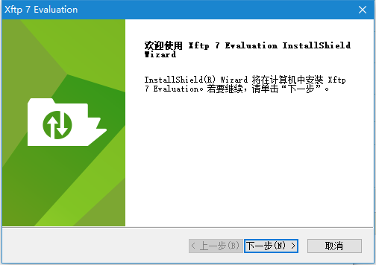

FTP服务器
Server-U
FileZillaServer
FTP客户端
SmartFTP
XFTP
FileZillaClient

